Slide 1
Matchings and Covers

Slide 2
Definitions:
A matching M in a graph G is a set of non loop edges with no shared endpoints.
G
M

Slide 3
Definitions:
The vertices incident to the edges of a matching M are saturated by M; the others are unsaturated ( we say M-saturated and M-unsaturated). A perfect matching in a graph is a matching that saturates every vertex.
G
M

Slide 4
Maximum & Maximal matchings
A maximal matching in a graph is a matching that cannot be enlarged by adding an edge. A maximum matching is a matching of maximum size among all matchings in the graph.
Maximal ≠ maximum

Slide 5
M-alternating path
Given a matching M, a M-alternating path is a path that alternates between edges in M and edges not in M
!M
M
!M
M

Slide 6
M-augmenting path
An M-alternating path whose endpoints are unsaturated by M.
!M
!M
!M
M
M
M-augmenting paths can be used to enlarge matchings.

Slide 7
Theorem
A matching M in a graph G is a maximum matching in G if and only if G has no M-augmenting path.
Only if: Trivial.

Slide 8
Symmetric difference
If G and H are graphs with vertex set V, then symmetric difference GΔH is the graph with vertex set V whose edges are all those edges appearing in exactly one of G and H.
We also use this notation for sets of edges; If M and M’ are matchings, then MΔM’ = (M-M’)∪(M’-M)

Slide 9
Symmetric difference M Δ M’
G
M
M’
M Δ M’

Slide 10
Lemma 1
Every component of the symmetric difference of two matchings is a path or an even cycle
Proof:
Let F = M Δ M’
1. Every vertix has at most one incident edge from M and M’ ( d(v) <=2 )
Because M and M’ are matchings
2. ∵ Δ( F ) <=2，every component of f is a path or a cycle.

Slide 11
Lemma proof (cont’d)
3. Every path or cycle in F alternates between edges of M and edges of M’
∴Every cycle has even length, with an equal number of edges from M and M’.
G
M
M’
M Δ M’

Slide 12
Proof of Theorem 1
If part: A matching M in a graph G is a maximum matching in G if G has no M-augmenting path.
Contrapositive: G has a matching larger than M => G has an M-augmenting path.
Proof:
Let M’ be a matching in G larger than M; we construct an M-augmenting path.

Slide 13
Proof of Theorem (cont’d)
Let F = M Δ M’ By Lemma 3.1.9 F consists of paths and even cycles. ( And they are M - M’ alternating)
Since |M’| > |M| F must have a component with more edges of M’ than of M
Cycles: Edges from M and M’ are of equal numbers.
Paths: Only start and ends with edges of M’
That is an M-augmenting path in G.

Slide 14
Hall’s Matching Condition
X, Y- bigraph and jobs filling problem
X
Applicants
Y
Jobs
Seek a matching that saturates X

Slide 15
Hall’s Theorem [theorem 2]
An X, Y-bigraph G has a matching that saturates X if and only if | N(S)| ≧ |S| for all S ⊆ X
Proof:
  Necessity: The |S| vertices matched to S must lie in N(S)
  Sufficiency: Contrapositive: If M is a maximum matching in G and M does not saturate X, then we can find a set S ⊆ X such that |N(S)| < |S|. (Notice that if maximum matching M doesn’t saturate X, implies X cannot be saturated anyway)

Slide 16
Proof of Hall’s Theorem (Sufficiency)
Let u ∈ X be a vertex unsaturated by M.
u…..M-alternating paths….. reachable: S and T ( u ∈ S)
X
S
u
Y
T

Slide 17
M matches T with S – {u}.
S – {u} is reached by an edge in M from a vertex in T.
T is all saturated. Because no M-augmenting path. ( M maximum)
1.&2. Bijection from T to S - {u} ∴ |T| = |S - {u}|
X
S
u
Y
T

Slide 18
T = N(S)
T ⊆ N(S) ( T are matched with S-{u})
No vertex in N(S) other than T ∴T = N(S)
Suppose y ∈ Y – T has a neighbor v ∈ S.
vy not in M: Because u is unsaturated and all the rest of S is matched to T by M.
thus adding vy to an M-alt. path to v yields an M-alt. path to y => contradiction y not reachable
X
S
v
u
Y
T = N(S)
y (doesn’t exist)

Slide 19
Completes the proof
T = N(S) ∴|N(S)| = |T| = |S| -1 < |S|
For a X,Y- bigraph which X cannot be saturated, we have found a subset S of X , such that |N(S)| < |S|. We always can find it.

Slide 20
Corollary
For k >0, every k-regular bipartite graph has a perfect matching.
Proof:
Counting edges by endpoints in X and in Y. k|X| = k|Y| ∴|X|=|Y| . Perfect problem -> Hall’s condition. (Because saturating X also saturates Y)
For all S ⊆ X, let m : number of edges from S to N(S). From S: m = k|S|. From N(S): m ≤ k|N(S)|. ∴ k|S| ≤ k|N(S)|. Hall’s condition satisfied.

Slide 21
Vertex cover
Definition: A vertex cover of a graph G is a set Q ⊆ V(G) that contains at least one endpoint of every edge. Q covers E(G).
Policemen watch(cover); Minimum cover.
No vertex can cover more than one edge of a matching.
Min Vertex Cover of G ≥ Maximum Matching of G
G

Slide 22
Theorem 3
If G is a bipartite graph, then the maximum size of a matching in G equals the minimum size of a vertex cover of G.
Proof: Let Q be a vertex cover, M be a matching in G. |Q| ≥ |M|. Given a smallest Q, we construct a matching of size |Q|

Slide 23
Proof
R = Q∩X，T = Q∩Y.
H: the subgraph of G induced by
R∪(Y-T); H’ the subgraph induced by T∪(X-R).
X
R
S
H’
H
Y
T

Slide 24
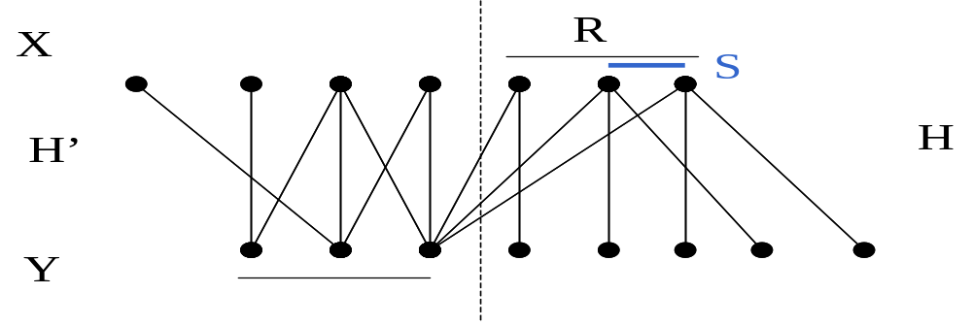
Use Hall’s theorem to show H has a matching that saturates R into Y-T, and H’ has a matching that saturates T. Since H and H’ are disjoint, the two matchings form a matching of size |Q| in G.
Since R∪T is a vertex cover, G has no edge from Y-T to X – R.
For each S ⊆ R, N_{H}(S) is contained in Y-T. If |N_{H}(S) |
< |S| then we can substitute N_{H}(S) for S!!! And form a vertex cover smaller than Q. But Q is minimum. So R is saturated in H. Similarly T is saturated in H’.
T
N_{H}(S)

Slide 25
Min-max relation
A maximization problem M and a minimization problem N defined on the same instances.
Dual pair: if for every solution m in M and for every solution n in N, m ≤ n then “=“ proves both.

Slide 26
Independent Sets and Covers
The Independence number of a graph is the maximum size of an independent set of vertices. (Independent set: within which any pair of vertices is not adjacent)
No edge contains two vertices of an independent set.
(compares: No vertex covers two edges of a matching)

Slide 27
Edge cover
Definition: And edge cover of G is a set L of edges such that every vertex of G is incident to some edge of L.
Vertices of G are covered by the edges of L.
Only G’s without isolated vertices.
G

Slide 28
Dual problems. Notation:
Maximum size of independent set α(G)
Maximum size of matching α’(G)
Minimum size of vertex cover β(G)
Minimum size of edge cover β’(G)
We already have: In bipartite G,
α’(G) = β(G).
β’(G) ≥ α(G)

Slide 29
Lemma 2
In a graph G, S ⊆ V(G) is an independent set if and only if S-bar is a vertex cover, and hence α(G) + β(G) = n(G).
Proof:
Only if: since S is an independent set, then every edge is incident to at least one vertex of S-bar. i.e. S-bar is a vertex cover. ( S to S, S to S-bar, S-bar to S-bar)
If: S-bar covers all edges, then there are no edges joining vertices of S (S-bar’s bar)

Slide 30
Theorem 4
If G is a graph without isolated vertices, then α’(G) + β’(G) = n(G).
Construction both sides:
From a maximum matching M …. An edge cover of size n(G) - |M|. ∴β’(G) ≤ n(G) – |M| (α’(G)).
From a minimum edge cover L…..A matching of size n(G) - |L|, ∴α’(G) ≥ n(G) – |L| (β’(G))

Slide 31
From a maximum matching M …. An edge cover of size n(G) - |M|
Adding to M one edge incident to each unsaturated vertex. (We can always find such edge incident to M) This is an edge cover.
Green use 1 vertex, blue use 2
  ∴ the size of this edge cover
  = n(G) - |M|
G
M

Slide 32
From a minimum edge cover L …. A matching of size n(G) - |L|
Every component of L has at most one vertex v such that d(v) > 1, and is a star.
In L:
Shouldn’t be in L.
Otherwise green one can be omitted
v
d(v) > 1

Slide 33
From a minimum edge cover L …. A matching of size n(G) - |L| (cont’d)
2. Let L has k components ( k stars). Summing all edges of these stars: |L| = n(G) – k .
3. Choosing one edge from each star in L, we form a matching M of size k = n(G) - |L|
L: k stars
M: size k

Slide 34
Corollary
By two constructions:
β’(G) ≤ n(G) – α’(G)
α’(G) ≥ n(G) – β’(G)
∴ α’(G) + β’(G) = n(G).
Corollary: If G is a bipartite graph with no isolated vertices, then α(G) = β’(G)
By Lemma and Theorem,
α(G)+β(G)= α’(G) + β’(G)

